Slide 1
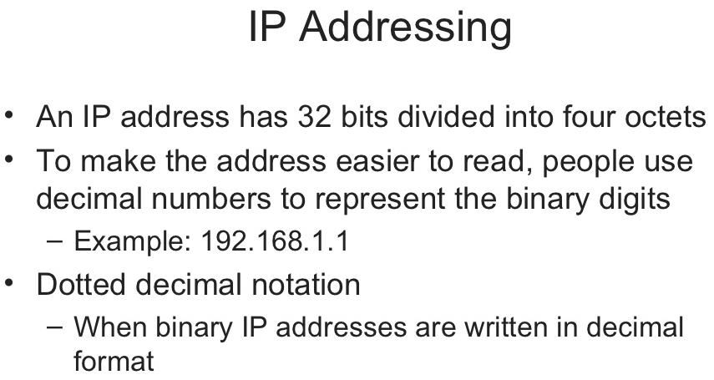
For Class_A- Net_ID. Host_ID.Host_ID.Host_ID/8
For Class_B- Net_ID. Net_ID.Host_ID.Host_ID/16
For Class_C- Net_ID. Net_ID. Net_ID. Host_ID/24
Start- 00000000.00000000.00000000.00000000
END- 11111111.11111111.11111111.11111111

Slide 2
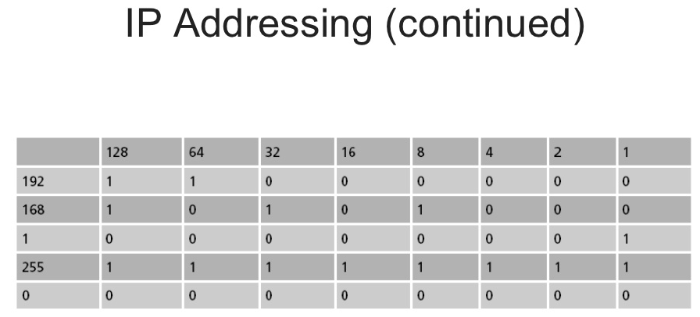

Slide 3
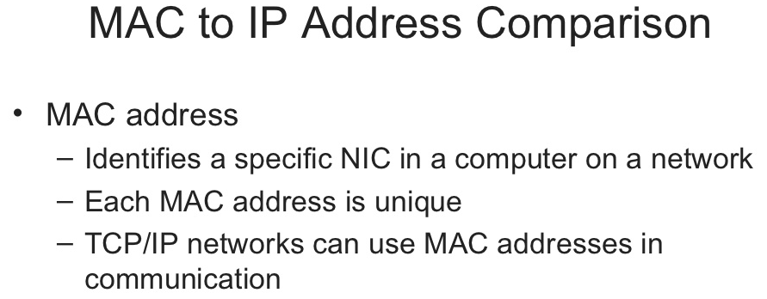
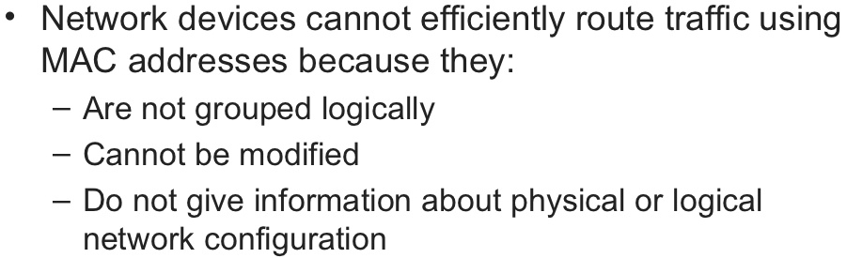

Slide 4
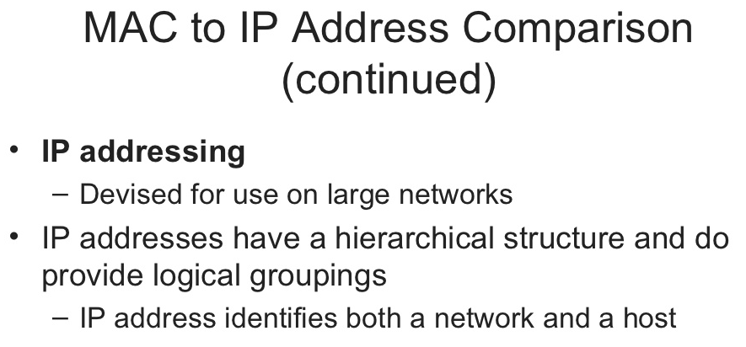

Slide 5
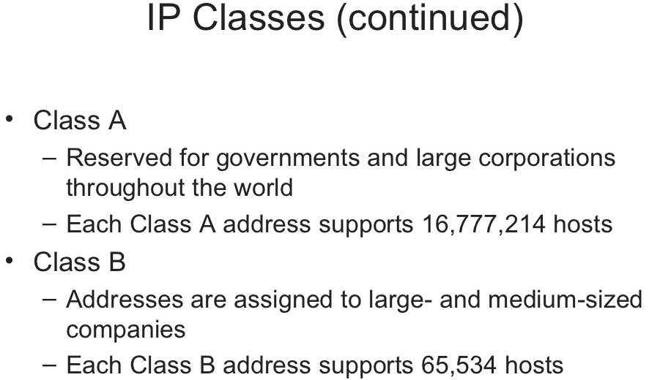

Slide 6
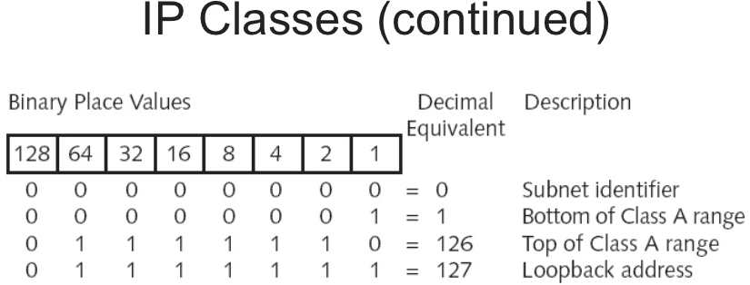
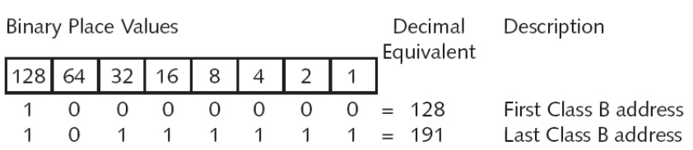

Slide 7
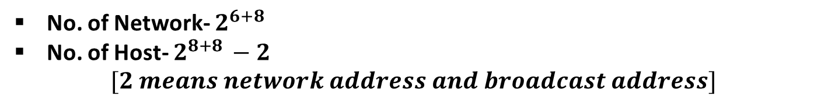
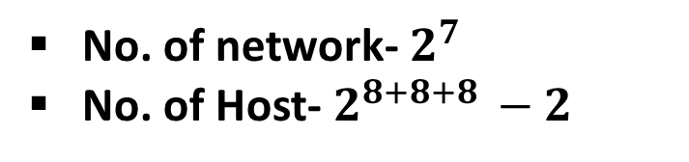
Class-A IP address Range
Net_ID | Host_ID | Host_ID | Host_ID
1 | 0 | 0 | 0
… | … | … | …
127 | 255 | 255 | 255
No. of network- $2^{7 }$
No. of Host- $2^{8+8+8 }−2$
Class-B IP address Range
Net_ID | Net_ID | Host_ID | Host_ID
128 | 0 | 0 | 0
… | … | … | …
191 | 255 | 255 | 255
No. of Network- $2^{6+8 }$
No. of Host- $2^{8+8 }−2$
$$[2 means network address and broadcast address]$$

Slide 8
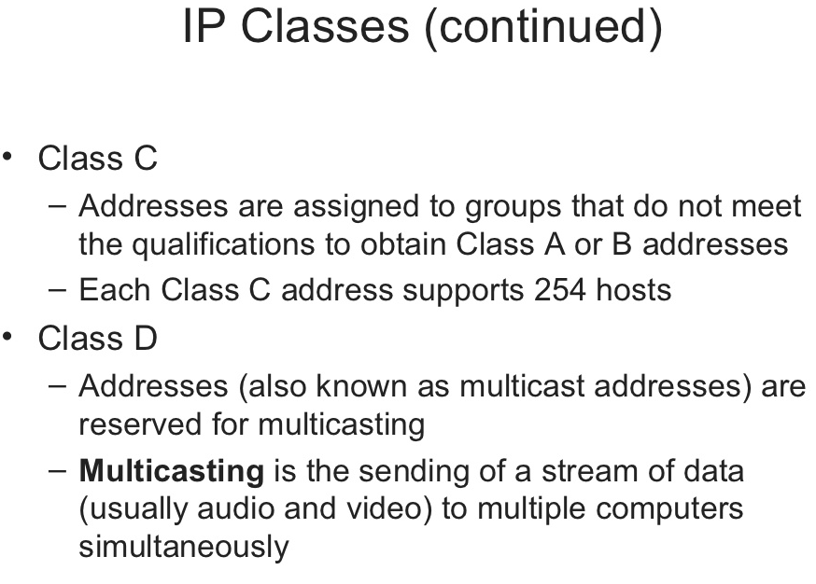

Slide 9
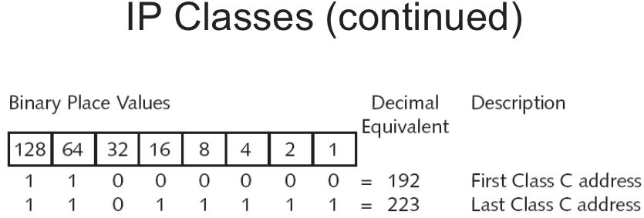
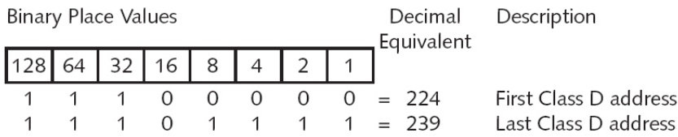

Slide 10
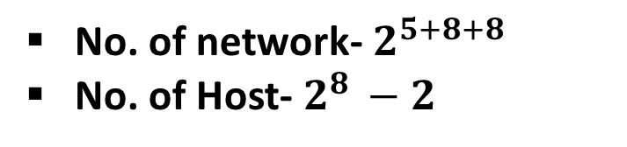
Class-C IP address Range
Net_ID | Net_ID | Net_ID | Host_ID
192 | 0 | 0 | 0
… | … | … | …
223 | 255 | 255 | 255
No. of network- $2^{5+8+8 }$
No. of Host- $2^{8 }−2$

Slide 11
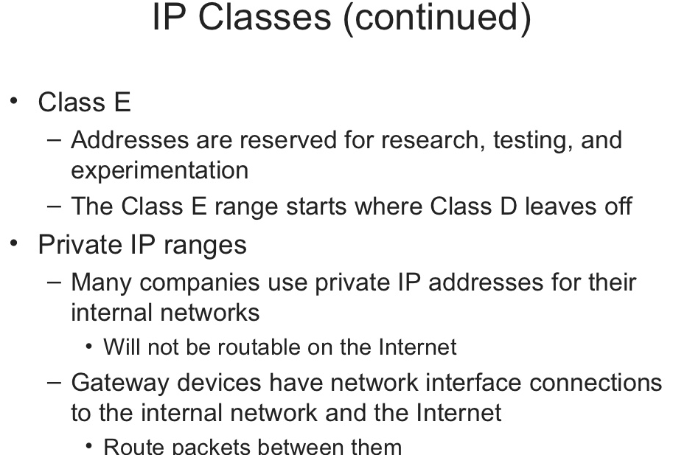

Slide 12
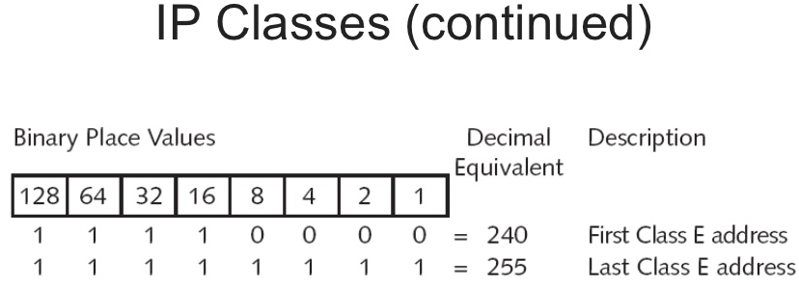
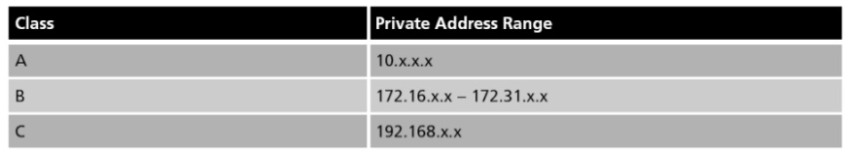

Slide 13
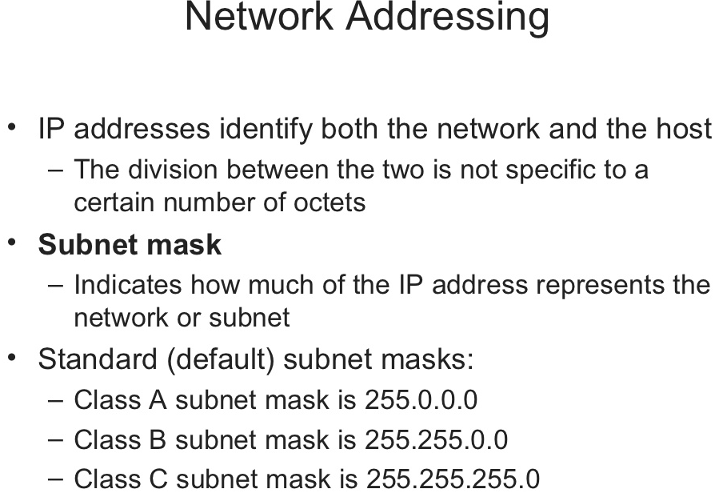

Slide 14
Calculate the Network and Broadcast address from IP address
For Network_address: Host part is 0
For Broadcast_address: Host part is 1
Class_A: 100.125.120.10/8
Network_address: 100.0.0.0
Broadcast_address:100.255.255.255
Class_B: 172.168.120.10/16
Network_address: 172.168.0.0
Broadcast_address:172.168.255.255
Class_C: 192.168.120.10/24
Network_address: 192.168.120.0
Broadcast_address:192.168.120.255

Slide 15
Calculate the Subnet mask from IP address
For Subnet_mask: Network part is 1
Class_A: 100.125.120.10/8
Subnet_mask:255.0.0.0
Class_B: 172.168.120.10/16
Subnet_mask:255.255.0.0
Class_C: 192.168.120.10/24
Subnet_mask:255.255.255.0

Slide 16
From IPv4 to IPv6
2001:8080:2abf:0010:0000:0212:1234:0001
Prefix Length Subnets Interface ID/Host
2001:8080:2abf:10:0:212:1234:1
2001:8080:2abf:10::212:1234:1
Converting from IPv4 to IPv6
192.168.100.100
11000000 10101000 01100100 01100100
C
0
6
4
A
8
6
4
C0A8
6464
:: C0A8:6464

